Slide 1
Fuel delivery and Mechanic provider

Slide 2

Team introduction
Unstoppable Innovators
C.E.O :- Dhruv Bhikadiya
C.O.O :- Dharmik Chhodavadiya
C.T.O :- Shreyansh Buha
C.M.O :- Jignesh Bambhaniya
C.F.O :- Abhi Boghara

Slide 3

fuemech
Your problem solving companion
We deliver fuel and provide mechanic at your location

Slide 4
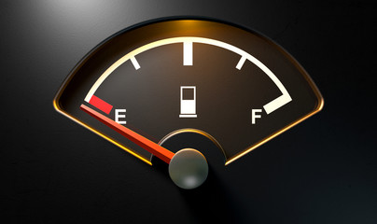
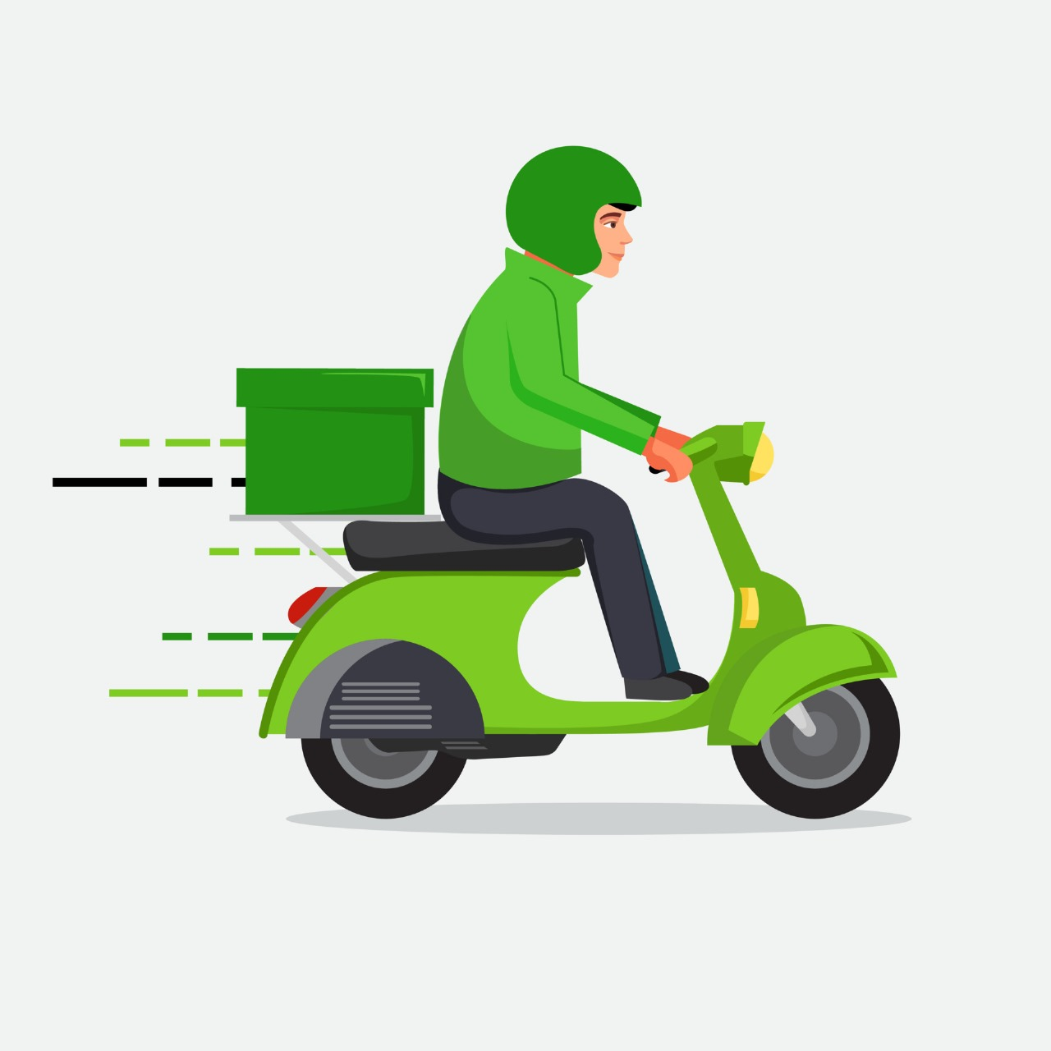
Problem & Solution
In this situation we will deliver fuel to your location.
In short our website is designed to save precious time and effort of customer and make your work easy.
run out of fuel in vehical.
we have to push the vehicle to the nearest petrol pump and it takes a lot of effort and wastes time.

Slide 5
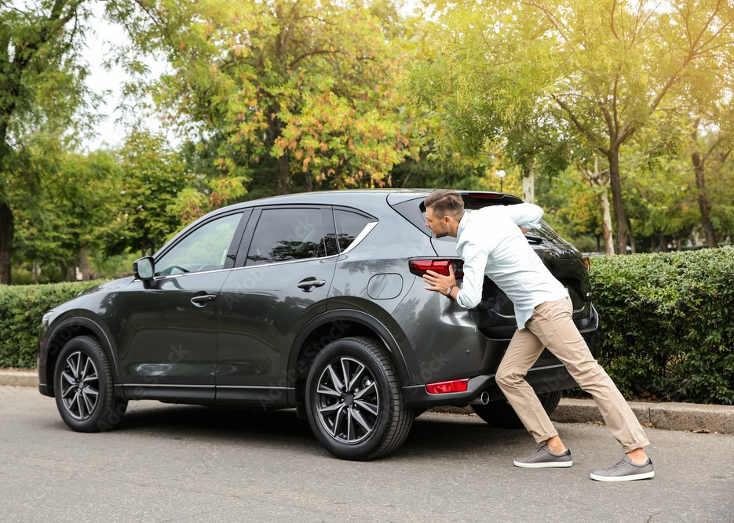

Problem & Solution
In this situation we will provide mechanic to your location.
In short our website is designed to save precious time and effort of customer and make your work easy.
Vehicle breaks down.
we have to push the vehicle to the nearest mechanic shop and it takes a lot of effort and wastes time.

Slide 6
Why is this solution urgently needed?
Emergency Situations: Customers might find themselves stranded on the road due to a breakdown or an empty fuel tank. In such situations, quick access to fuel or a mechanic becomes crucial.
Convenience: People often lead busy lives, and having fuel delivered or a mechanic come to their location saves time and effort compared to going to a gas station or an auto repair shop.
Remote Locations: In rural or less populated areas, access to gas stations or repair shops might be limited. Delivery services can be essential in such locations where traditional options are scarce.
Time Sensitivity: For businesses that rely on vehicles or machinery for their operations, any downtime can result in financial losses. Urgent fuel delivery or mechanical assistance is crucial to minimizing disruptions.
Weather Conditions: Adverse weather conditions, such as extreme cold or heat, can make traditional trips to a fuel station or repair shop challenging. Delivery services provide a more comfortable solution.
Non-Operational Vehicles: Some customers may have vehicles that are not currently operational and need fuel or repairs at their location.

Slide 7
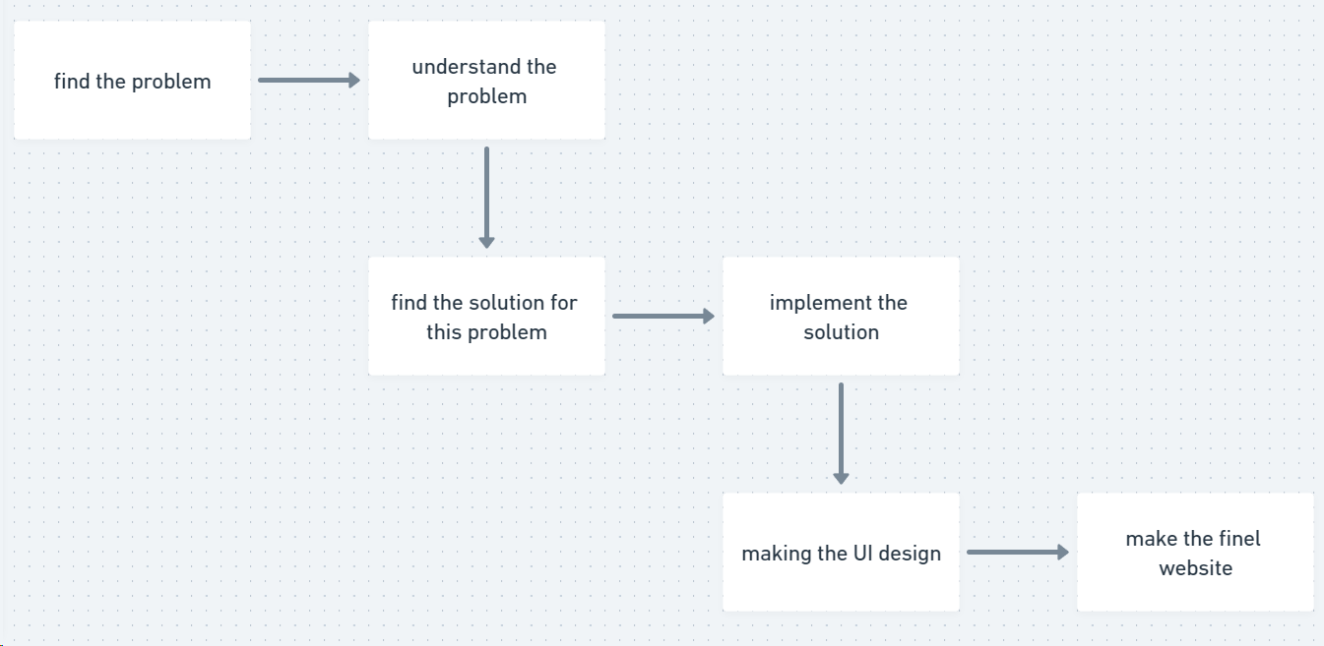
Flowchart

Slide 8
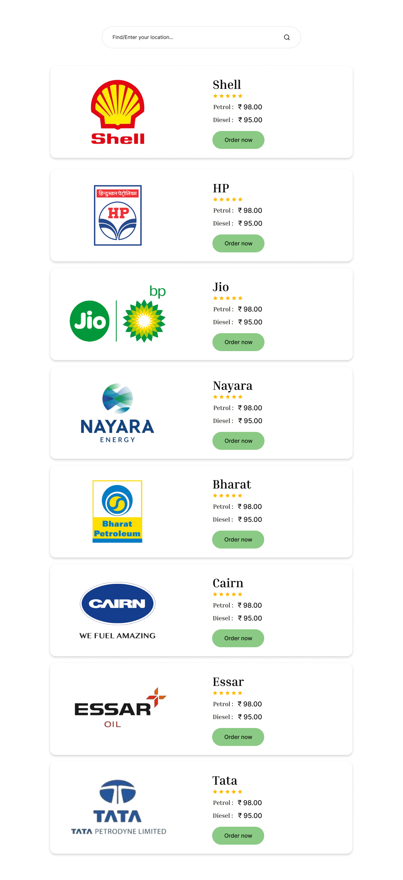
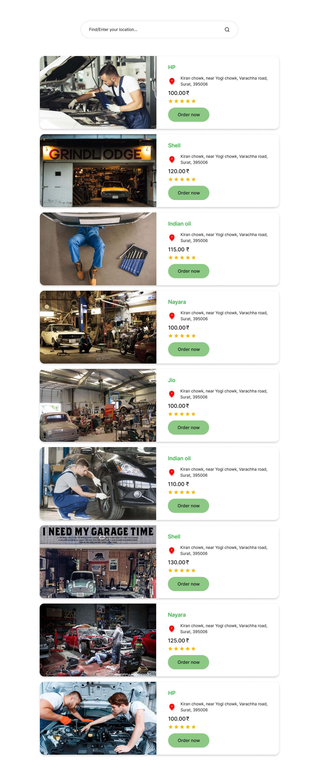

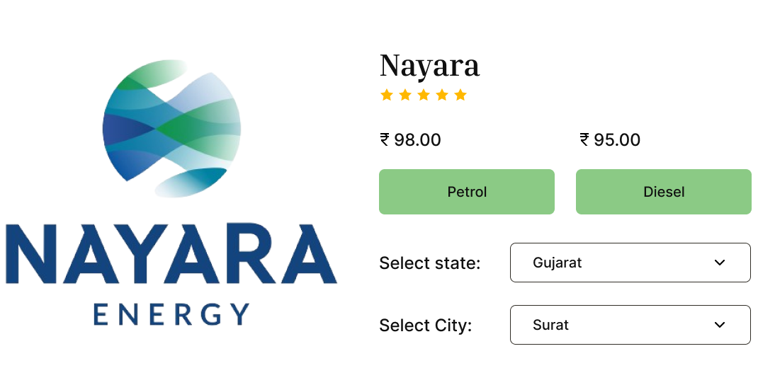
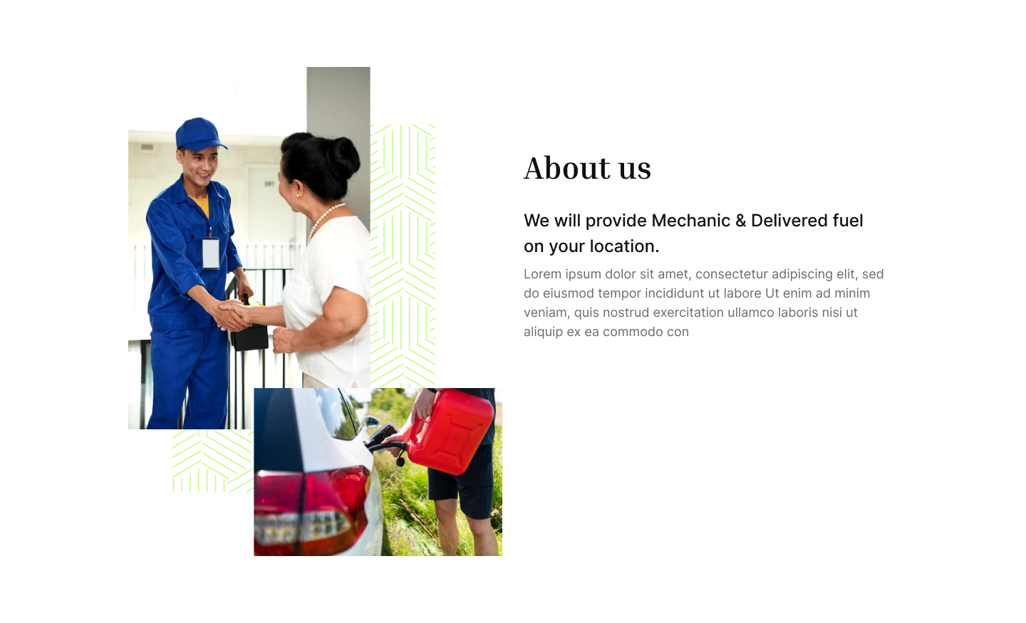
UI Representation

Slide 9
Real Market Surveys
Fuel delivery market is expected to be appraised at US$ 5,064.1 million in 2023 and is poised to reach US$ 10,086.4 million by 2033.
During the forecast period, the global mobile fuel delivery market appears to witness a bright future, with opportunities in passenger cars, heavy commercial vehicles, hybrid vehicles, and light commercial vehicles.
The mobile fuel delivery market is anticipated to record a CAGR of 7.1% during the forecast period.
The global automotive repair and service market was valued at $789.8 billion in 2021, and is projected to reach $1,656.21 billion by 2031, growing at a CAGR of 7.6% from 2022 to 2031.

Slide 10
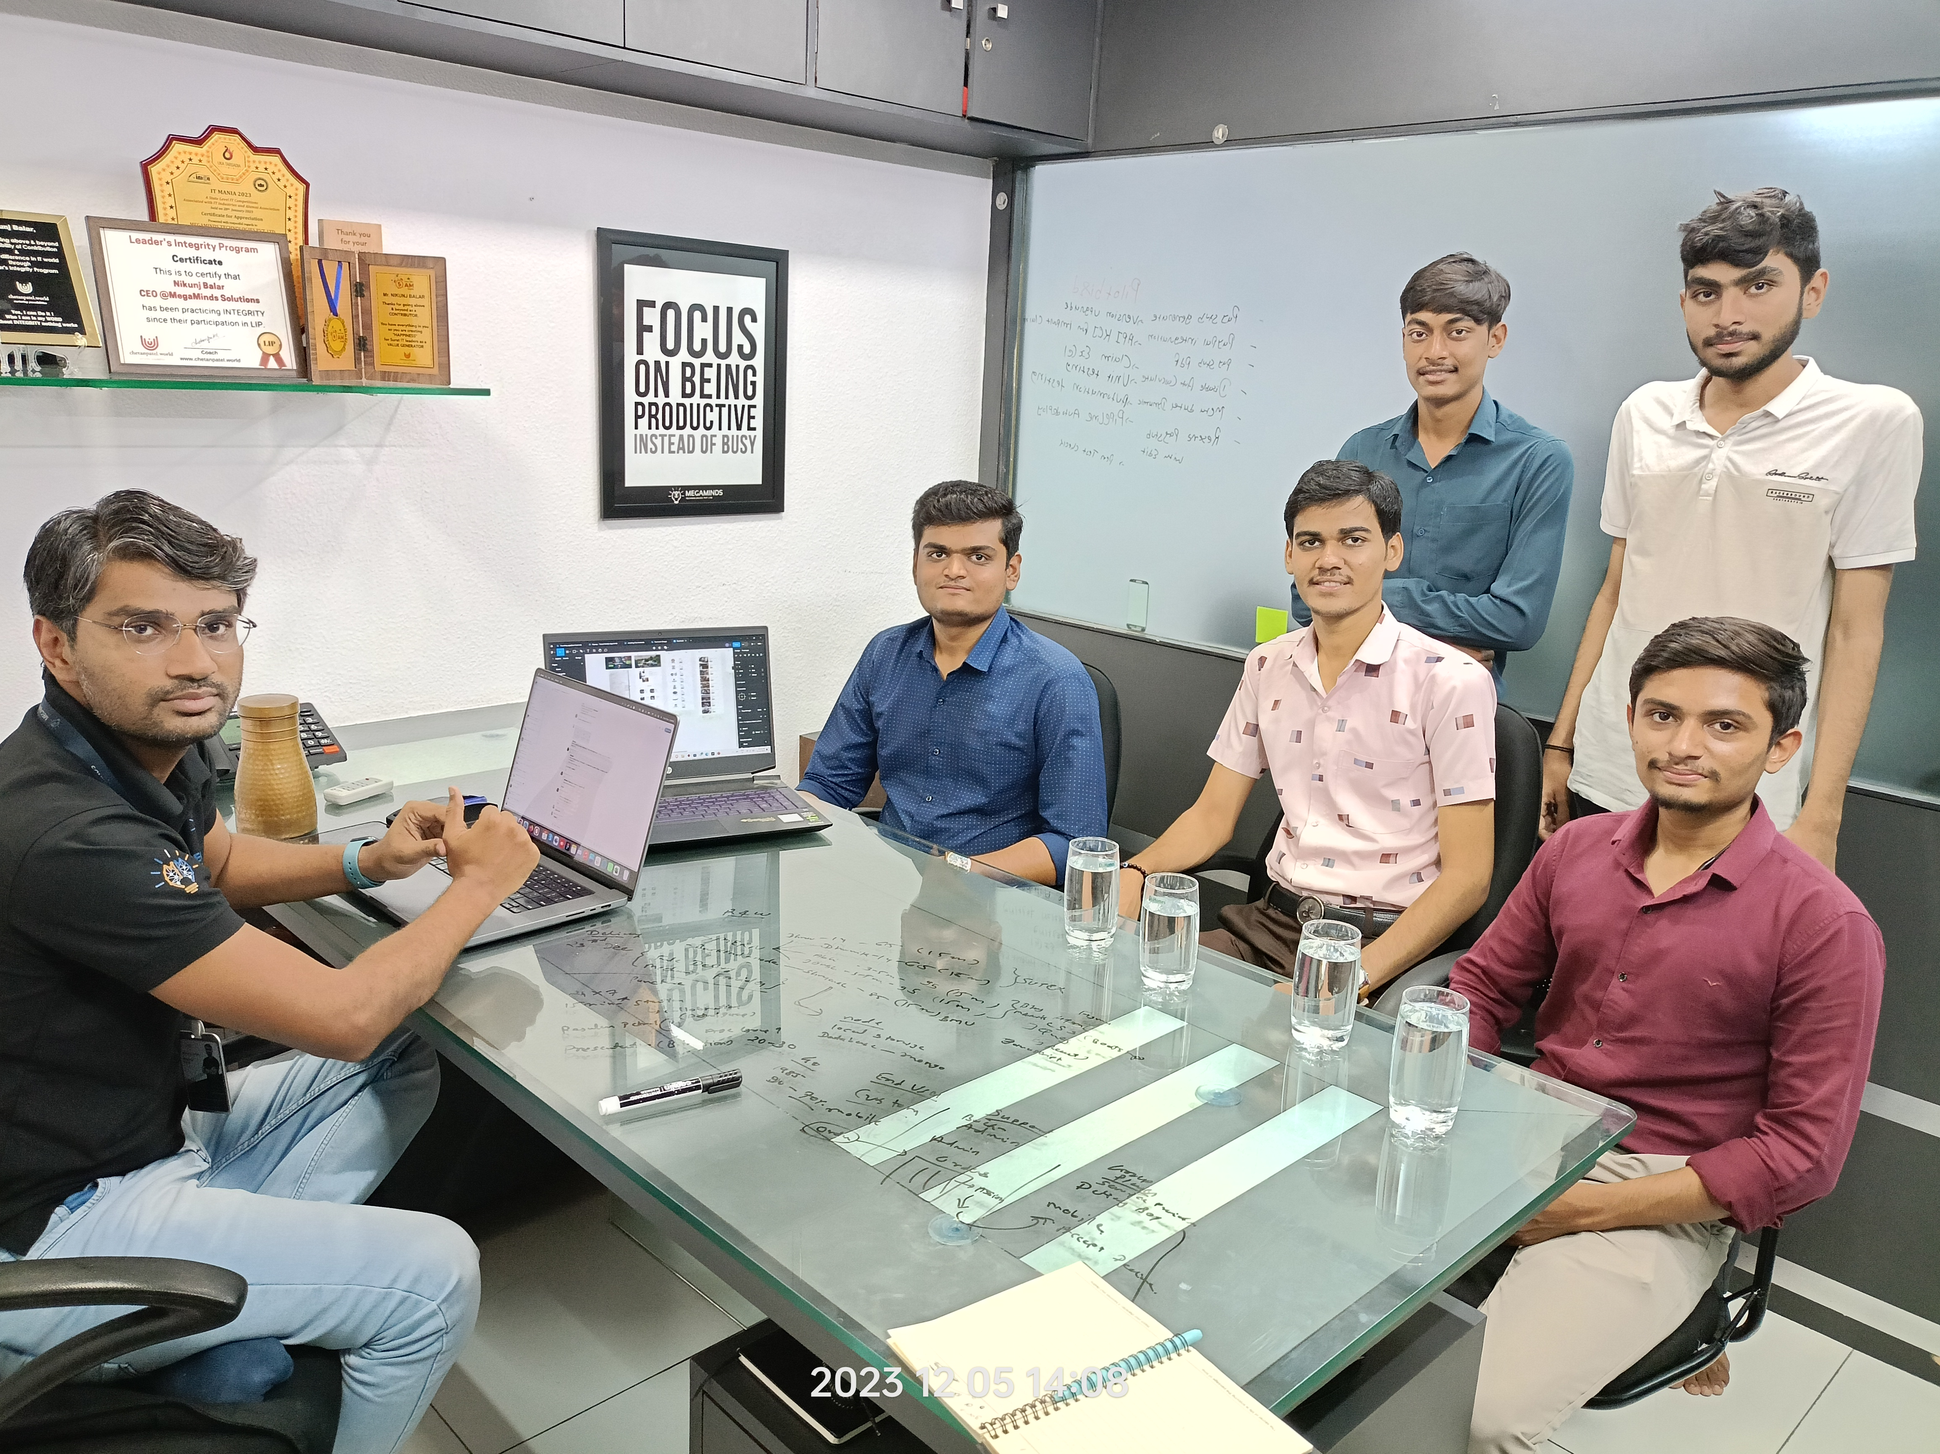
Idea Pitch in IT Company
We went to megaminds technology to pitch our idea. Meeting with him was very good and he suggested us many things and we will definitely add those things in our thought and he will give us feedback as below.
“ Your idea is very unique, capable according to the current world and many things can be added to this idea in the future. ”
- Mr. Nikunj Balar
(C.E.O of megaminds technology)

Slide 11
Thank you
From Team – Unstoppable Innovators

